Slide 1
CSE 4208
Introduction to OpenGL Libraries
Dr. Sk. Md. Masudul Ahsan
Professor,
Dept. of CSE,
KUET
Md. Tajmilur Rahman
Lecturer,
Dept. of CSE,
KUET

Slide 2
Outline
Objectives of graphics programming
What is OpenGL?
The evolution of the OpenGL pipeline
A simplified pipeline model
Course Ground Rule
OpenGL related libraries
﻿Core-profile vs Immediate mode
State machine
Object
OpenGL’s geometric primitives
Shaders and GLSL
OpenGL programming in a nutshell
References

Slide 3
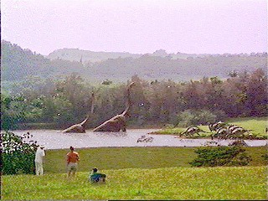
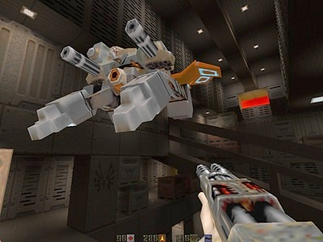
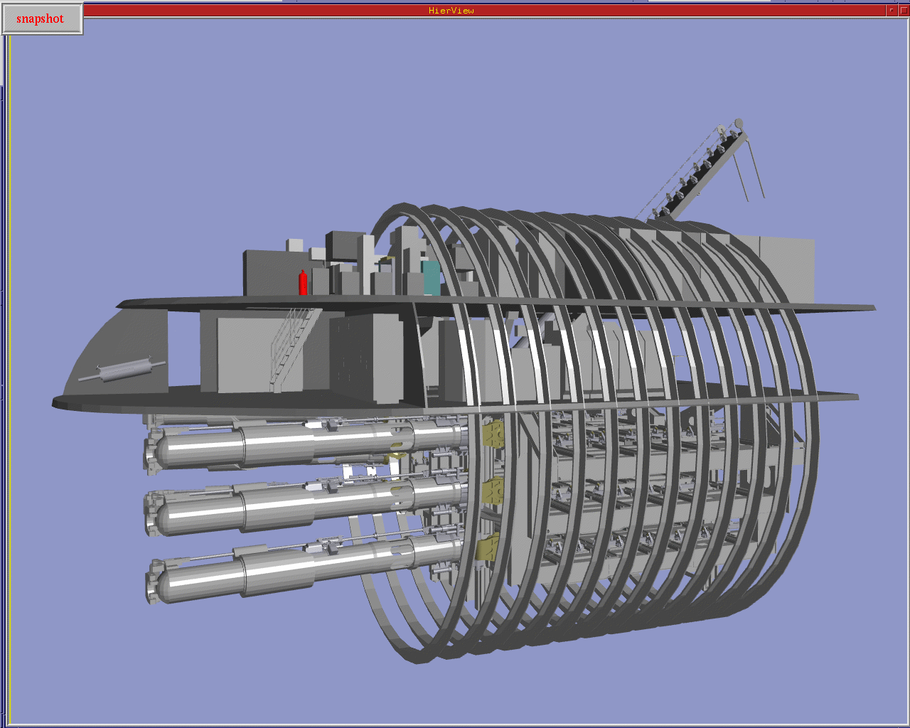
Objectives of graphics programming
To create a synthetic image in such a way that it is close to reality.
To create artificial animation that emulates virtual reality.
But why we need that?

Slide 4
What is OpenGL?
OpenGL is a computer graphics rendering API
  To create interactive applications that render high-quality color images composed of 3D geometric objects and images.
  Forms the basis of many interactive applications that include 3D graphics.
  OpenGL API is window and operating system independent.
    OpenGL needs a window to draw into.
    This is controlled by the windowing system (GLFW or some other library).

Slide 5

The evolution of the OpenGL pipeline
OpenGL 1.0 was released on July 1st, 1994
Its pipeline was entirely fixed-function
  the only operations available were fixed by the implementation
The pipeline evolved, but remained fixed-function through OpenGL versions 1.1 through 2.0 (Sept. 2004)
Vertex
Data
Vertex Transform and Lighting
Primitive
Setup and Rasterization
Fragment Coloring and Texturing
Blending
Pixel
Data
Texture
Store

Slide 6
The evolution of the OpenGL pipeline
OpenGL 2.0 (officially) added programmable shaders
  vertex shading augmented the fixed-function transform and lighting stage
  fragment shading augmented the fragment coloring stage
However, the fixed-function pipeline was still available
Vertex
Data
Vertex Transform and Lighting
Primitive
Setup and Rasterization
Fragment Coloring and Texturing
Blending
Pixel
Data
Texture
Store

Slide 7
An evolutionary change
OpenGL 3.0 introduced the deprecation model
  The method used to remove features from OpenGL
The pipeline remained the same until OpenGL 3.1 (released March 24th, 2009)
Introduced a change in how OpenGL contexts are used

Slide 8
The exclusively programmable pipeline
OpenGL 3.1 removed the fixed-function pipeline
  programs were required to use only shaders
Additionally, almost all data is GPU-resident
  all vertex data sent using buffer objects
Vertex
Data
Vertex
Shader
Primitive
Setup and Rasterization
Fragment
Shader
Blending
Pixel
Data
Texture
Store

Slide 9
More Programmability
OpenGL 3.2 (released August 3rd, 2009) added an additional shading stage – geometry shaders
Vertex
Data
Vertex
Shader
Primitive
Setup and Rasterization
Fragment
Shader
Blending
Geometry
Shader
Pixel
Data
Texture
Store

Slide 10
A simplified pipeline model
Application
GPU Data Flow
Framebuffer
Vertices
Vertices
Fragments
Pixels
Vertex
Processing
Rasterizer
Fragment Processing
Vertex
Shader
Fragment
Shader

Slide 11
Course Ground Rule
We’ll concentrate on OpenGL version 3.3
  Allows more efficient use of GPU resources
If you’re familiar with “classic” graphics pipelines, modern OpenGL doesn’t support
  Fixed-function graphics operations
    lighting
    Transformations
All applications must use shaders for their graphics processing

Slide 12
Shortly
CPU → writes a list of points
VBO → stores points on GPU
VAO → tells how to read them
Vertex shader → moves points (Transformations)
Fragment shader → colors pixels

Slide 13
OpenGL related libraries
GL – gl.h – Opengl32.lib
  Provides basic commands for graphics drawing
GLFW – glfw3.h – glfw3.lib
  ﻿Gives us the bare necessities required for rendering goodies to the screen.
  ﻿It allows us to create an OpenGL context, define window parameters, and handle user input, which is plenty enough for our purposes.
GLAD – glad.h
  ﻿Retrieves the location of the functions needed at run time and stores them in function pointers for later use.

Slide 14
﻿Core-profile vs Immediate mode
Immediate mode
  ﻿Referred to as the fixed function pipeline.
  ﻿Easy-to-use method.
  ﻿Most of the functionality of OpenGL was hidden inside the library.
  ﻿Developers did not have much control over how OpenGL does its calculations.
Core profile mode
  ﻿Removed all old deprecated functionality.
  ﻿It is very flexible and efficient but difficult to learn.
  ﻿This modern approach requires the developer to truly understand OpenGL and graphics programming.

Slide 15
State machine
OpenGL is by itself a large state machine:
A collection of variables that define how OpenGL should currently operate.
The state of OpenGL is commonly referred to as the OpenGL context.
We often change its state by setting some options, manipulating some buffers and then render using the current context.

Slide 16
State machine
﻿Whenever we tell OpenGL that we now want to draw something it draws using the current context.
We change the state of OpenGL by changing some context variable that sets how OpenGL should draw.
As soon as we change the context and tell OpenGL to draw something, the next drawing commands will now draw according to the new context.

Slide 17
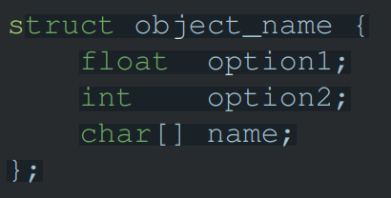
Object
﻿A collection of options that represents a subset of OpenGL’s state.
We could have an object that represents the settings of the drawing window;
We could then set its size, how many colors it supports and so on. One could visualize an object as a C-like struct:

Slide 18
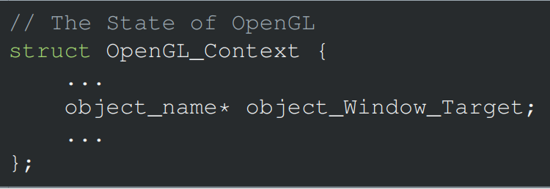
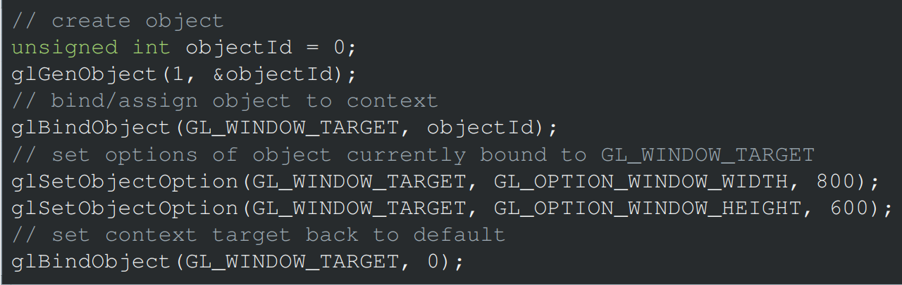
Object
﻿This little piece of code is a workflow you’ll frequently see when working with OpenGL.

Slide 19
OpenGL’s geometric primitives
All primitives are specified by vertices
GL_POINTS
GL_LINES
GL_LINE_STRIP
GL_LINE_LOOP
GL_TRIANGLES
GL_TRIANGLE_FAN
GL_TRIANGLE_STRIP
Notes:
To form 3D geometric objects, you need to decompose them into geometric primitives that OpenGL can draw. OpenGL only knows how to draw three things: points, lines, and triangles, but can use collections of the same type of primitive to optimize rendering.

Slide 20
OpenGL’s geometric primitives
To form 3D geometric objects, you need to decompose them into geometric primitives that OpenGL can draw.
OpenGL only knows how to draw three things: points, lines, and triangles,
    But can use collections of the same type of primitive to optimize rendering.

Slide 21
Shaders and GLSL (OpenGL Shading Language)
Data Types
Scalar types: float, int, bool
Vector types: vec2, vec3, vec4
ivec2, ivec3, ivec4
bvec2, bvec3, bvec4
Matrix types: mat2, mat3, mat4
Texture sampling: sampler1D, sampler2D, sampler3D, samplerCube
C++ Style Constructors vec3 a = vec3(1.0, 2.0, 3.0);

Slide 22
Operators
Standard C/C++ arithmetic and logic operators
Operators overloaded for matrix and vector operations
mat4 m;
vec4 a, b, c;
b = a*m;
c = m*a;

Slide 23
Components and Swizzling
For vectors can use [ ], xyzw, rgba or stpq
Example:
vec3 v;
v[1], v.y, v.g, v.t all refer to the same element
Swizzling:
vec3 a, b;
a.xy = b.yx;

Slide 24
Qualifiers
in, out
  Copy vertex attributes and other variable to/ from shaders
  in vec2 tex_coord;
  out vec4 color;
Uniform: variable from application
  uniform float time;
  uniform vec4 rotation;

Slide 25
Flow control
if
if else
expression ? true-expression : false-expression
while, do while
for

Slide 26
Functions
Built-in
  Arithmetic: sqrt, power, abs
  Trigonometric: sin, asin
  Graphical: length, reflect
User-defined

Slide 27
Built-in variables
gl_Position: output position from vertex shader
gl_FragColor: output color from the fragment shader
  Only for ES, WebGL and older versions of GLSL
  Present version uses an out variable.

Slide 28
Simple vertex shader example
in vec4 vPosition; // from VBO
in vec4 vColor; // from VBO
out vec4 color; // to fragment shader
void main()
{
// Pass the vertex color to the fragment shader
color = vColor;
// Set the final position of the vertex on the screen
gl_Position = vPosition;
}

Slide 29
Simple fragment shader example
in vec4 color; // from vertex shader
out vec4 FragColor; // to frame buffer
void main()
{
FragColor = color; //set pixel color
}

Slide 30
OpenGL programming in a nutshell
Modern OpenGL programs essentially do the following steps:
Create shader programs
Create buffer objects and load data into them
“Connect” data locations with shader variables
Render

Slide 31
References
https://learnopengl.com/Getting-started/OpenGL
Ed Angel, (2013), Introduction to Modern OpenGL Programming [PowerPoint slides], University of New Mexico. https://www.google.com/url?sa=i&rct=j&q=&esrc=s&source=web&cd=&cad=rja&uact=8&ved=0CAIQw7AJahcKEwiQmpaO9feAAxUAAAAAHQAAAAAQAg&url=https%3A%2F%2Fwww.cs.unm.edu%2F~angel%2FSIGGRAPH13%2FAn%2520Introduction%2520to%2520OpenGL%2520Programming.pptx&psig=AOvVaw2kK85Jyj7mtAWvopHq2SLZ&ust=1693056429705470&opi=89978449

